Slide 1
The Turing Test
“The jerk works at pacific coffee”
Can you write a Python program that counts the words in that sentence? One that tells you if any words shouldn’t be said to your mum?
PHIL2225, 23/1/24

Slide 2
Plan for today
I’m going to talk through some of the material at the start of the paper, presenting historical background and isolating some questions we should care about.
Turing’s question➔Turing’s new question➔Turing’s reason for changing the question➔Whether he was right to change the question
Then we might read through second half of the paper
& some logistic stuff

Slide 3
A remarkable prediction
The original question, "Can machines think?" I believe to be too meaningless to deserve discussion. Nevertheless I believe that at the end of the century the use of words and general educated opinion will have altered so much that one will be able to speak of machines thinking without expecting to be contradicted
He was off by ~20 or so years, but at least some would agree with him. In 2010, no one would have!

Slide 4
Our big big question
Can machines think? More specifically: can ChatGPT think?
Think about it!!!!!!!
But what are ‘machines’? And what is ‘thinking’?

Slide 5
Machines are computers

Slide 6
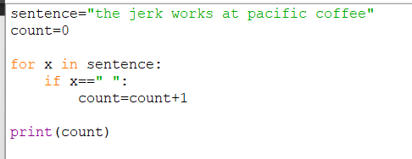
Computers
Computers can do things. Most of the things you can do with Python today you could do with a 50s style computer. So we’ll talk about Python.

Slide 7
It’s a bit more complicated…

Slide 8
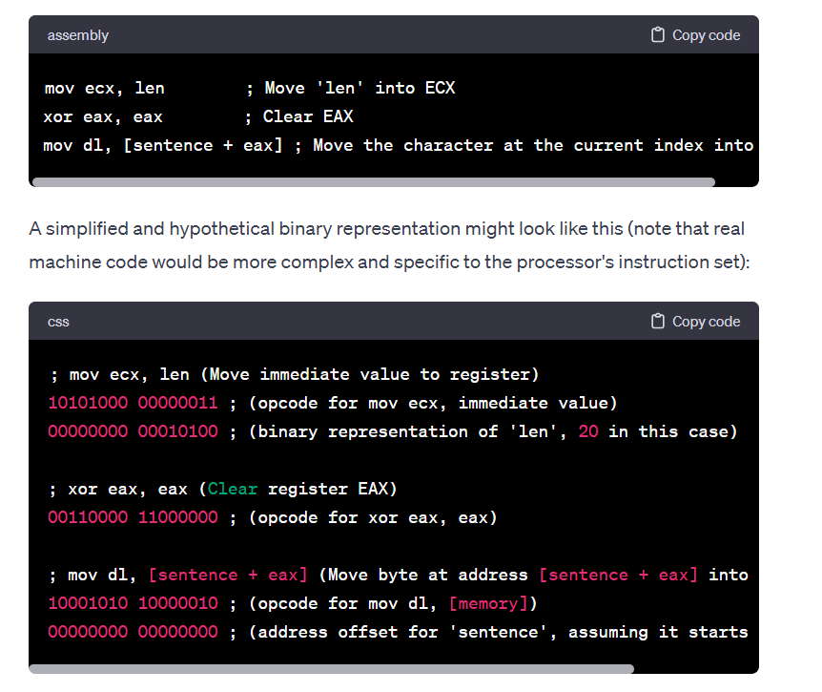
It’s MORE complicated
When ‘programming’ in 1950s, you’d be writing things like this

Slide 9
Other things computers can do …
Count the number of characters (easy)
Find the first occurrence of ‘e’
Reverse the string

Slide 10
Things computers couldn’t do
Completely trivial: deal with mistakes “the jerk works in pacific coffee” (will say there’s 6 words)
Less trivial: find rhymes
Even less trivial: find words you shouldn’t say to your grandma
And then so much more:

Slide 11
Sooo much more

Slide 12
Why we’re here …
The reason we’re looking at Turing, the reason you’re in this class, the reason I get paid … the last slide has changed the game.

Slide 13
SO
A ‘machine’ is a ‘digital computer’ which is, for us, a Python program like you wrote in high school. Want to know more? The Annotated Turing, Code (Petzold)
What is thinking? A harder question!

Slide 14
What is thinking? ……
…………………..

Slide 15
Turing’s ‘imitation game’

Slide 16
Why care about this ‘imitation game’?
It’s interesting, of course. It’s fun to think about. But more.
“I propose to consider the question, "Can machines think?" This should begin with definitions of the meaning of the terms "machine" and "think." The definitions might be framed so as to reflect so far as possible the normal use of the words, but this attitude is dangerous, If the meaning of the words "machine" and "think" are to be found by examining how they are commonly used it is difficult to escape the conclusion that the meaning and the answer to the question, "Can machines think?" is to be sought in a statistical survey such as a Gallup poll. But this is absurd. Instead of attempting such a definition I shall replace the question by another, which is closely related to it and is expressed in relatively unambiguous words.”

Slide 17
Why care, more
This is the philosophical crux. This is what you need to think about.
Q1. Why does Turing think the question as to whether machines think is too vague?
Q2. Is changing the question as he does a good move?
Q3. Can we say that passing the test suffices for thinking?

Slide 18
Why too vague? Historical answer
Behaviourism was formerly, and in the 50s, in vogue as a theory of psychology.
Imagine you’re studying something: greebles, let’s call them.
Problem is: greebles are invisible.
Greebles’ activity is correlated with something visible
One sort of behaviourism: ignore greebles! Just study the visible thing. (‘methodological behaviourism’)
Another sort: say that greebles actually are the visible thing. (‘radical behaviourism’)

Slide 19
Behaviourism 101
Greebles: mental states
Pain is just pained behaviour, thought is just a sort of cognitive behaviour (or: we should only study pained behaviour and cognitive behaviour)
Hypothesis: Turing thought that ‘think’ was too vague because he was influenced by the behaviourist psychology of the time.
* But is behaviourism true?

Slide 20
Against behaviourism
Noam Chomsky is widely taken to have demolished behaviourism about language.
An extremely extremely unsophisticated and unfair caricature of behaviourism about language: you say ‘mouse’ when faced with a mouse; you say ‘mouse’ loudly and repeatedly when you’re sure it’s a mouse: reference and certainty, mental properties, are behavioural.
(True for Cantonese? strength of feeling is length of particle: 好凍呀呀呀呀呀呀)

Slide 21
The funniest passage in 20th academia
It does not appear completely obvious that in this case the way to impress the owner is to shriek Beautiful! in a loud, high-pitched voice, and with no delay (high response strength). It may be equally effective to look at the picture silently (long delay) and then to murmur Beautiful in a soft, low-pitched voice (by definition, very low response strength).

Slide 22
Recap….
Turing starts with ‘can machines think?’
Doesn’t like that question
I suggested it’s because he’s a behaviourist
We’re not behaviourists anymore
Is his methodology bad?

Slide 23
Is Changing the q a good move?
It happens very frequently in science that we change the question:
We want to know whether corydalis yanhusuo kills pain
We change the question: does it bind to mu opiate receptors?
And we change the question again: are its effects reversed by naloxone?
We want to know whether eating junkfood in adolescence leads to greater risk-seeking behaviour in adulthood
We change the question: are gambling anonymous meetings in state S, where Nestle have contracts with the schools, more attended than in state T, where good food is served?

Slide 24
A conclusion ….
It’s perfectly respectable scientific practice to change the question. So maybe Turing was right to change the question (even if he did it for outdated reasons). That means, it’s possible that if something passes the imitation game, we may as well say that it thinks.
Turing’s question is alive and well in 2024!

Slide 25
Let’s look at the objections!

